Slide 1
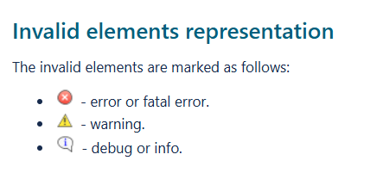
Validation in Catia
Purpose – Checks the accuracy, completeness, and correctness of a model
Validation Suites – Groupings of validation rules
Elements that violate the rules are reported in the Validation Results panel and marked
https://docs.nomagic.com/display/MD2022x/Validation
Notes:
“When a model passes validation, you KNOW it is compliant…Validation is fast and consistent, Seconds/Minutes vs. Hours”
Validation suites - Models are validated against a set of validation rules. Each validation rule captures an imperative condition that must be checked against the model. Validation rules are grouped into meaningful groups called validation suites. There are predefined validation suites that you can customize. You can also create your own rules and group them into suites. Validation rules and suites can be exported into a separate project in order to reuse them.
The validation can run on the entire model or on a selected part of it. All the elements in that scope are checked against relevant validation rules, and elements that violate these rules are reported in the Validation Results panel.

Slide 2
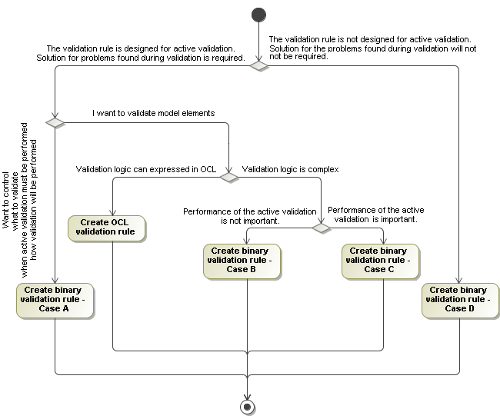
Constraints in Catia
https://docs.nomagic.com/display/MD190/Create+OCL2.0+validation+rule
Notes:
Flow to Validation with OCL

Slide 3
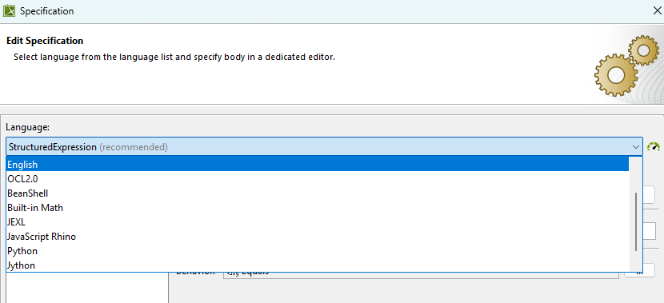
From OCL to Structured Expressions
Specifying rules for more advanced concepts is hard in OCL (i.e, string formatting)
Catia allows rules to be written in other languages and invoked during validation
Notes:
"Sometimes it is hard to specify the rule for some advanced concepts in OCL. For example, the string manipulation is rather weak in OCL2.0, hence the writing rule for string formats, parsing strings is very hard in OCL. In such cases the modeling tool offers possibility to write rules in other languages and invoke them when validating."
https://docs.nomagic.com/display/MD190/Binary+validation+rule

Slide 4
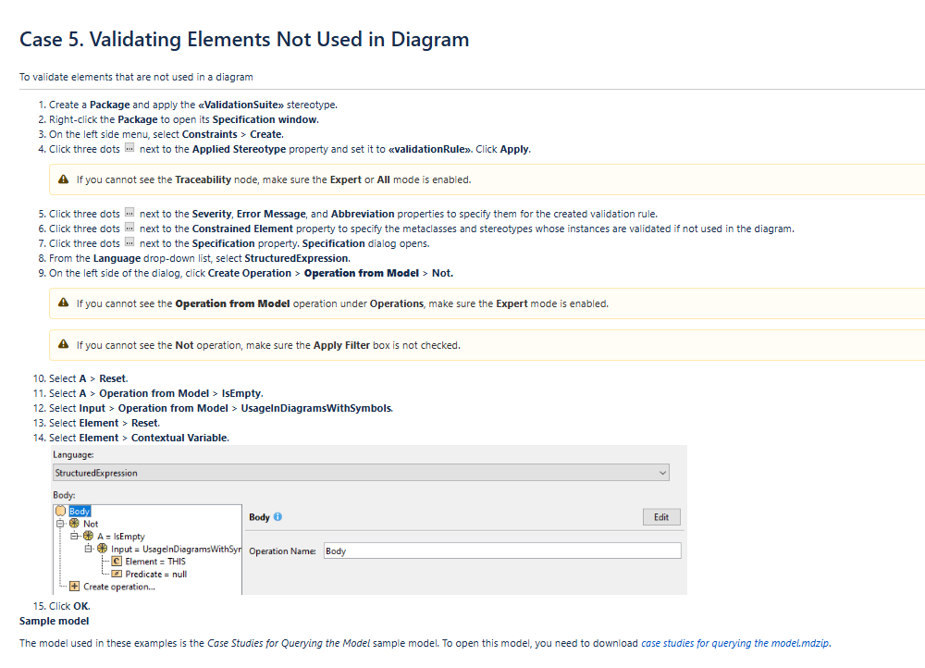
https://docs.nomagic.com/display/MD2022x/Case+5.+Validating+Elements+Not+Used+in+Diagram
Notes:
Now I want to query the model and validate it to specific constraints. These are some of the steps I followed. Straight from CATIA Tool Documentation

Slide 5
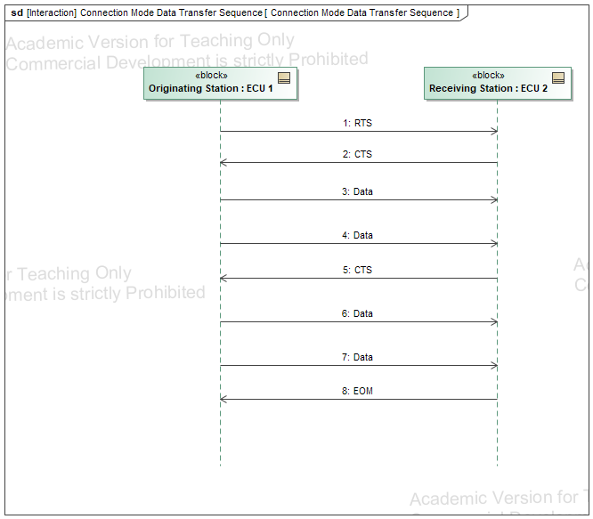
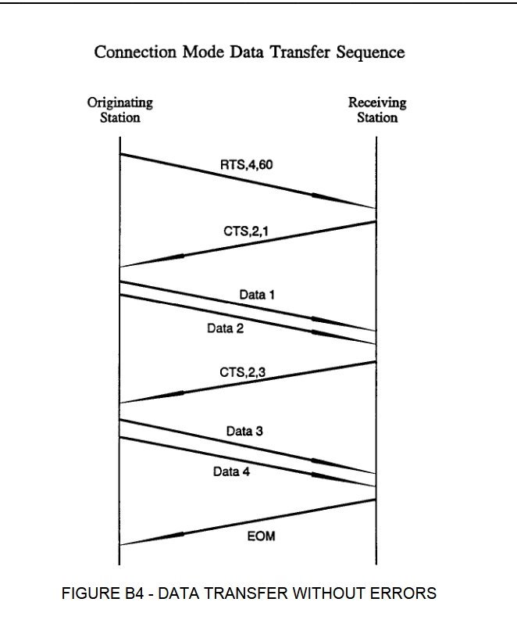
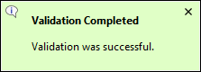
Passing
Source: SAE J1587 Protocol
Notes:
On the left you have the J1587 Protocol picture of the Connection Mode Data Transfer Sequence, how it should be done. And then on the right a successful validation of a model that follows those constraints.
Our protocol analysis of J1587 informed us of how data transfer works in the protocol. We know there is a connection in how messaging works in J1587 and J1939, so we can leverage previous research to replicate a few of those Transport protocol vulnerabilities in J1939 as model validations.
i.e
Connection Exhaustion
Request Overload
Malicious clear to send

Slide 6
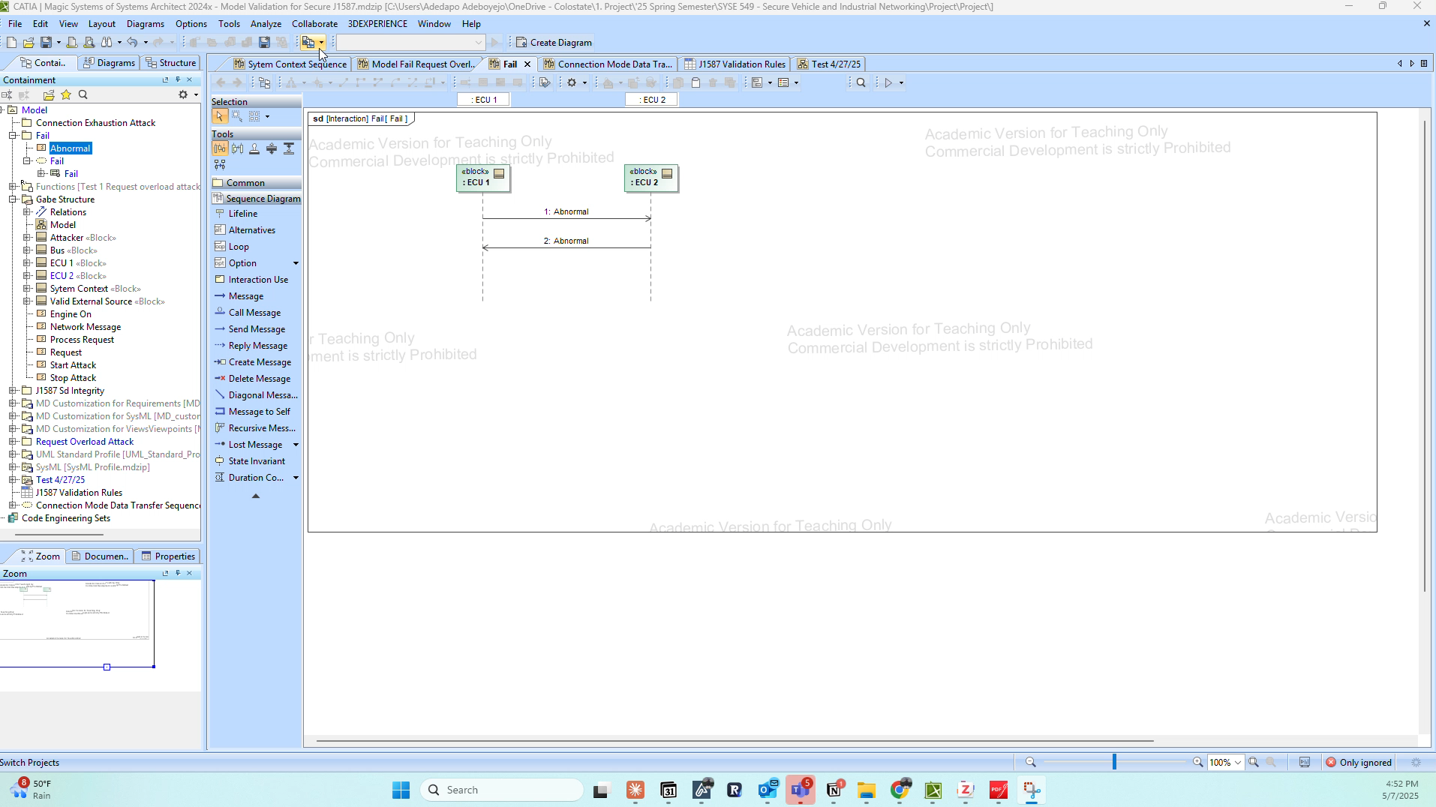
Fails

Slide 7
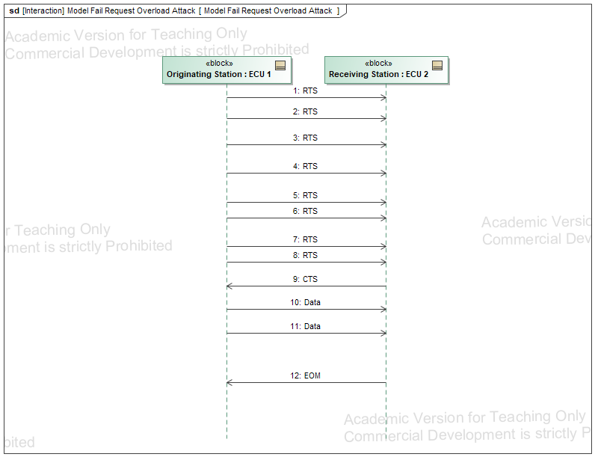
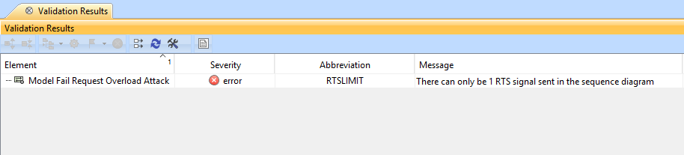
Fails

Slide 8
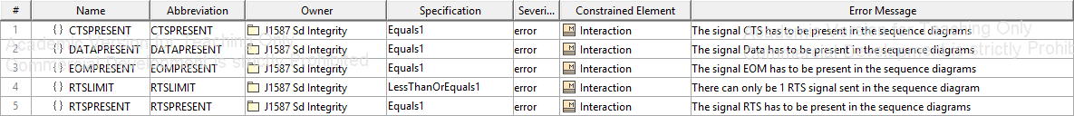
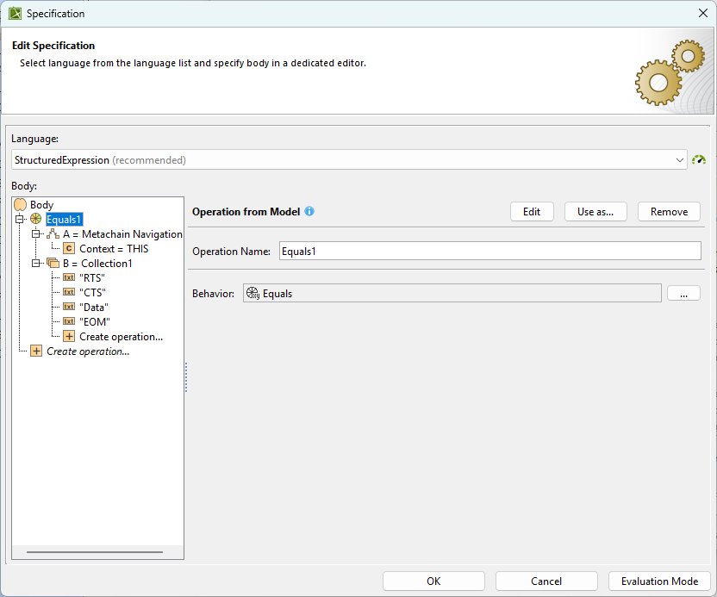
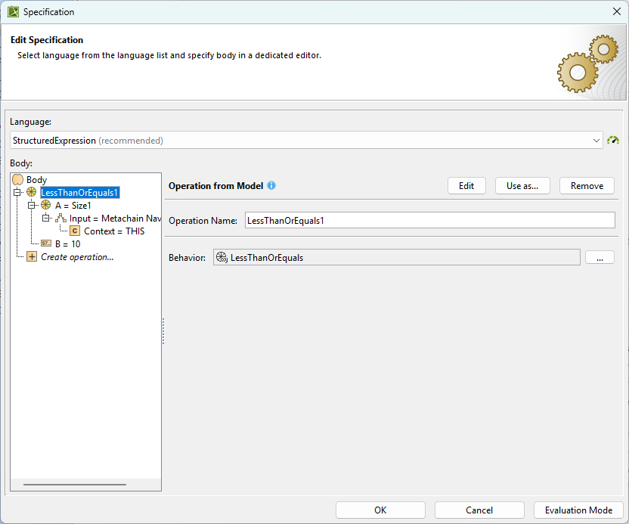
Validation Suite Documentation
Notes:
These are the specifications of the constraints
-Left: searching the diagram for the proper signals, RTS, CTS, Data, EOM
-Right: the check for too many RTS signals in a diagram that would highlight the Request to Overload Attack from earlier

Slide 9
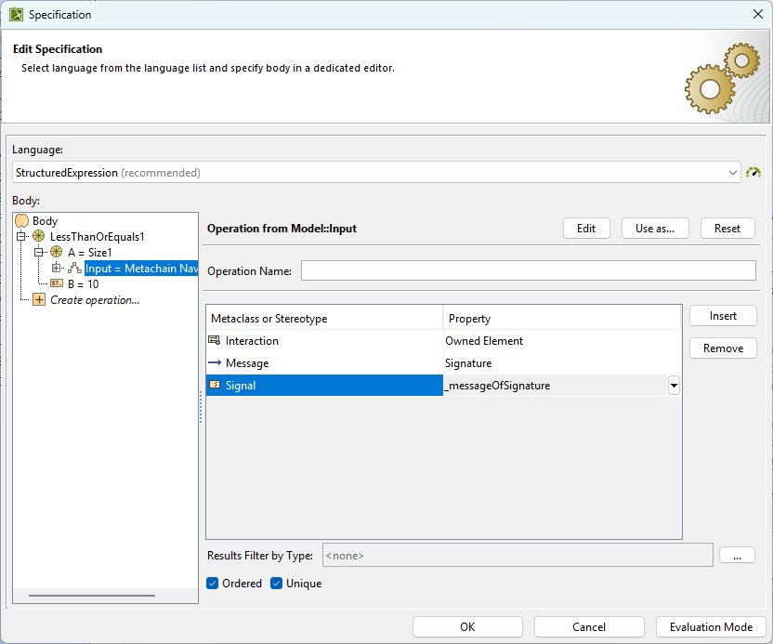
Metachains
Notes:
Structured Expressions in CATIA is a pretty niche skills but this is kind of how it is done. You have these built in operations to query and compare different elements that you metachain to. In this case I start at my constrained element the Sequence Diagram, and then going to the asynchronous messages. This would be the same process I follow for the CTS messages. Just checking for too many signals being sent

Slide 10
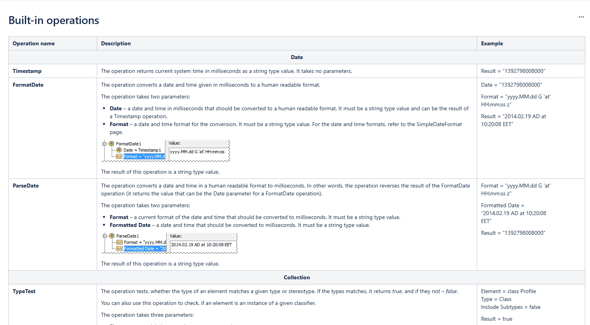
Built-in Operations
https://docs.nomagic.com/display/MD2024xR2/Built-in+operations
Notes:
Built in operations to Query the model and compare values. I had to learn to use my own because the examples from SAIC were not as easy to follow as I thought they would be.
Size
The operation returns the number of elements in collection.
The operation consist of:
Input - an object or collection (for example array, set, list, string).
LessThan
The operation returns true if the left parameter is less than the right parameter (A < B).
The operation consist of:
A and B - parameters which will be compared.
Equals
The operation converts parameters if they are not the same type, then compares them. If parameters are equal, operation returns Boolean value true, otherwise operation returns false.
The operation consist of:
A and B - parameters which will be compared

